Slide 1




YOUTUBE VIDEO DATA ANALYTICS
Group 12: Monica, Bhumika, Swathi, Bharath

Slide 2










TABLE OF CONTENT
Introduction
Project Goals
Dataset Used
Implementation
Expected Outcome

Slide 3

INTRODUCTION
YOUTUBE VIDEO DATA ANALITICS
This project aims to leverage Amazon Web Services to create a youtube trending video analytics service. The project contains different data engineering, data analysis, and data science sections.

Slide 4








PROJECT SCOPE
YOUTUBE VIDEO DATA ANALITICS
Data Ingestion - Create a data ingestion pipeline to extract new incoming data into the AWS data lake.
Data Lake - Create a centralized repository to store data from multiple sources and of different formats.
Data ETL Jobs - Create Extract, Transform, and Load jobs to preprocess raw data into usable proper versions.
Data Analysis - Create SQL queries to analyze data to create key insights about the product.
Data Reporting/Analytics - Create dashboards to answer questions and communicate insights to the Stakeholders.

Slide 5





The dataset contains daily statistics for trending YouTube videos with up to 200 trending videos per day. It includes several months of data on daily trending YouTube videos. Major nations covered in this dataset are US, GB, DE, CA, JP, IN, and FR regions.
DATASET
The dataset is sourced from Kaggle.
Link - https://www.kaggle.com/datasets/datasnaek/youtube-new/data
There are two parts to this dataset:
Each region’s trending video data is in a separate .csv file. Data includes both numerical and categorical columns.
Each video is also associated with its video category which is stored in a separate .json file that varies between regions.

Slide 6
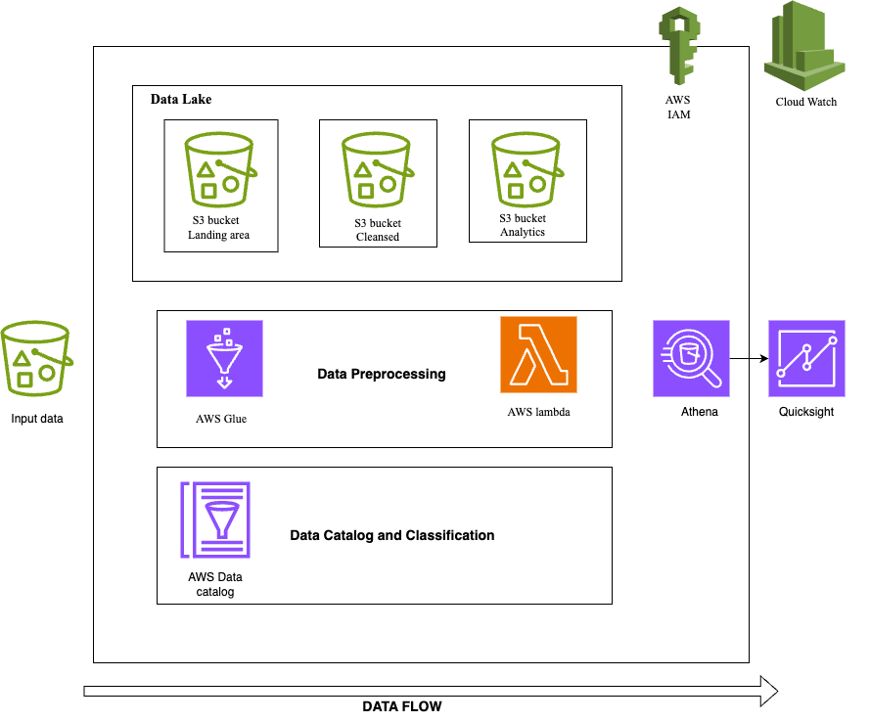
DATA FLOW

Slide 7





IMPLEMENTATION
STEP 1:
STEP 2:
Ingest data into Amazon S3 Bucket from Kaggle
Create a central repository of metadata of all the data assets in our project.
YOUTUBE VIDEO DATA ANALITICS
STEP 3:
Create a AWS Lambda function that processes any new incoming data and stores it in cleansed Amazon S3 buckets.
STEP 4:
Create a dashboard to visualize and answer questions according to business requirements and perform data analytics using AWS Athena.

Slide 8

EXPECTED OUTCOME
Purpose: Showcase detailed analytics through an intuitive dashboard.
Main Tool: Utilizes Amazon QuickSight for clear, accessible insights.
Flexibility: Designed for easy integration with various BI tools for expanded analysis.
YOUTUBE VIDEO DATA ANALITICS

Slide 9
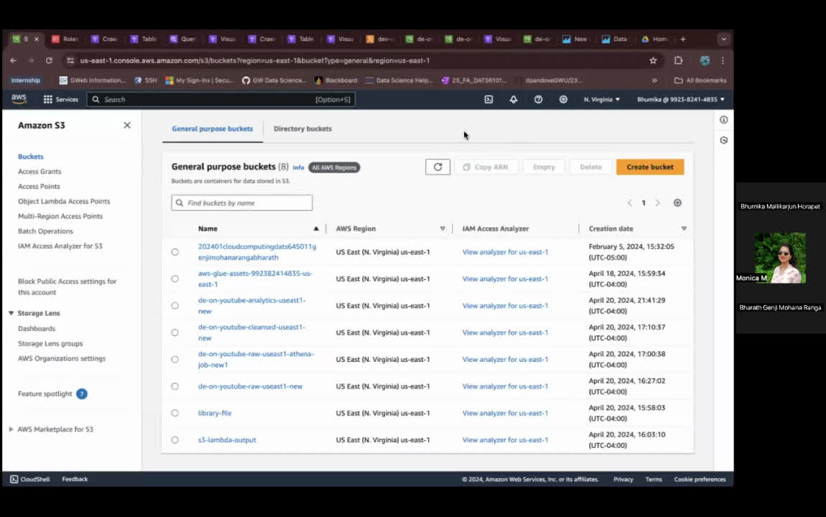
OVERVIEW
YOUTUBE VIDEO DATA ANALITICS

Slide 10

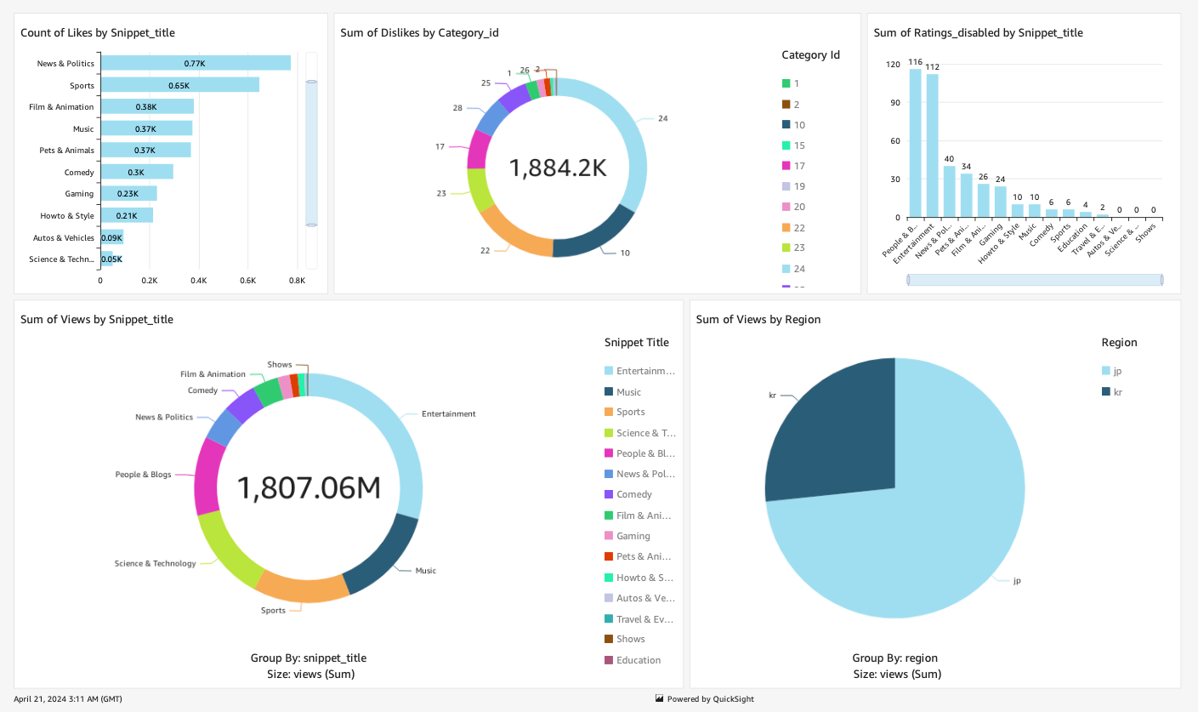
DASHBOARD
YOUTUBE VIDEO DATA ANALITICS

Slide 11

YOUTUBE VIDEO DATA ANALITICS
THANKYOU!

